Slide 1
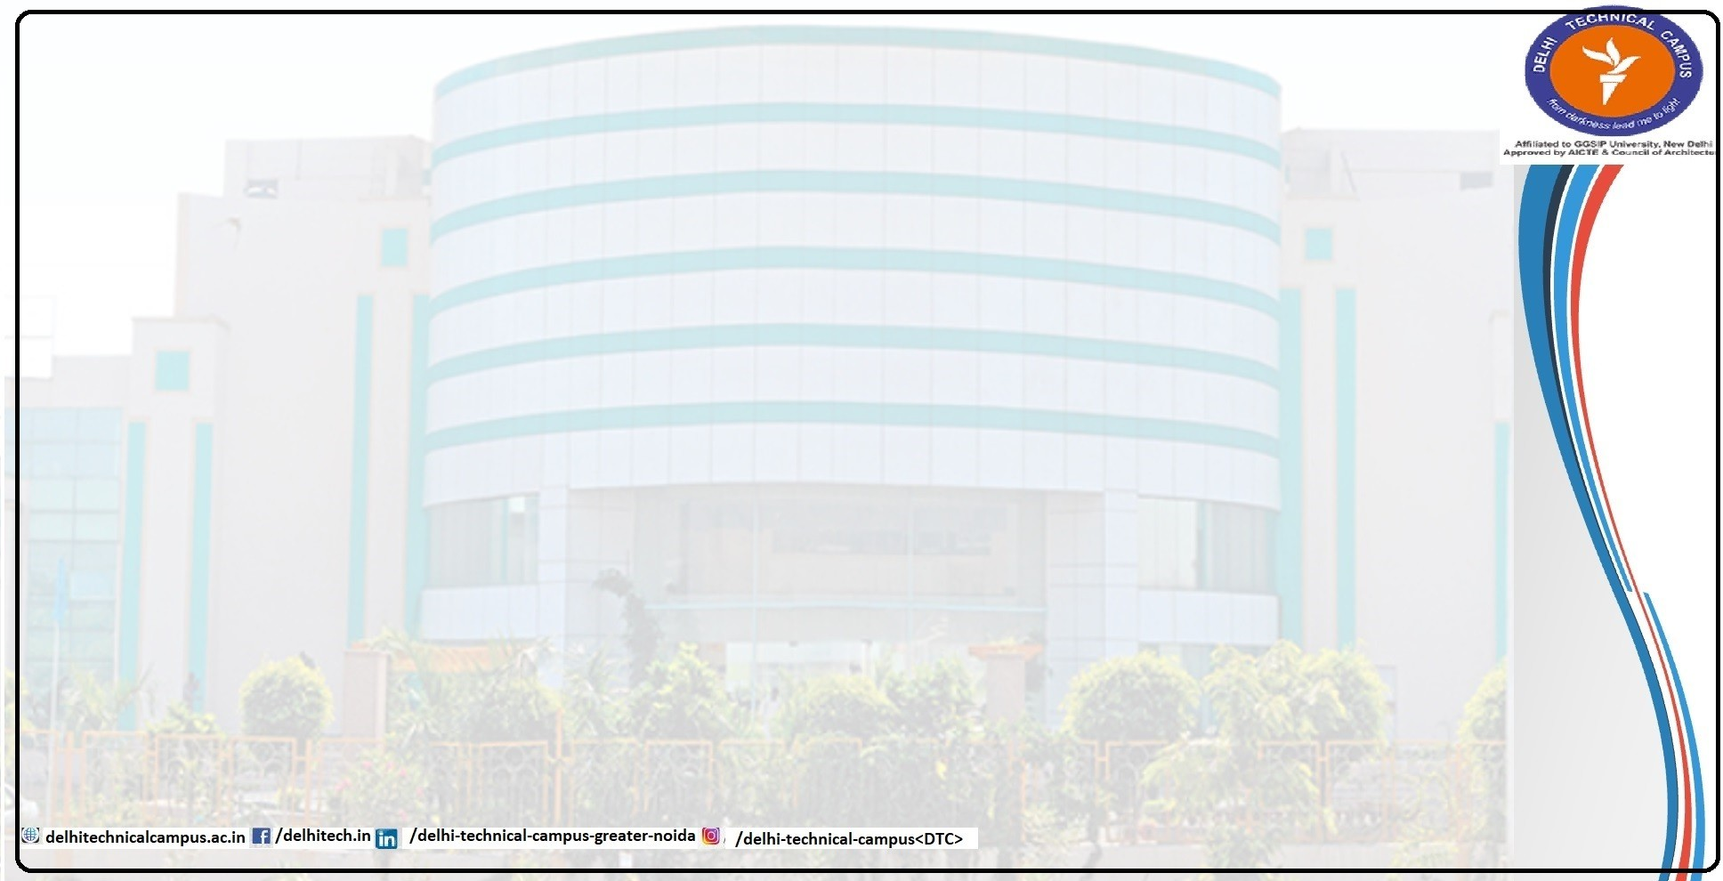
RouteShare:
An Intelligent Carpool System
Presented By
Shobhit Shukla(04618002722) Kumar Tejaswa(14718002722)
Under Guidance of
Mr.Vibhav Ranjan

Slide 2
INTRODUCTION
Problem Definition
Urban transportation faces issues like congestion, long travel times, and high commuting costs, while traditional ride- sharing lacks optimized matching, real-time updates, and reliable verification.
The problem is to develop an AI-driven carpool system that delivers optimized matching, secure transactions, real-time tracking, and a smooth user experience for affordable, efficient, and reliable daily commuting.
Feasibility Study Technical Feasibility:
AI-based routing integrated using OpenRouteService and geospatial algorithms.
Secure authentication implemented via JWT with encrypted data handling.
Integrates Stripe and AI modules Mistral for smooth operations.
Economic Feasibility:
Uses mostly open-source tools, reducing dependency on paid services.
Runs on standard hardware (CPU/GPU), reducing additional costs.
Operational Feasibility:
User-friendly interface with simple ride creation and booking options.
Real-time tracking and secured payments increase reliability and convenience.

Slide 3
Need and Significance
Modern commuters expects reliable,affordable and time efficient travel options.
Existing ride-sharing platforms lack AI-driven route optimization, proper user verification, and real-time coordination..
An intelligent carpool system enhances efficiency, safety, and travel convenience through smart matching and automation.
Objectives
To develop an AI-based intelligent carpool system for daily commuters. To provide ride matches that are optimized, reliable, and time-efficient. To integrate real-time tracking and smart routing for improved accuracy.
To offer a secure, easy-to-use, and seamless interface for both drivers and passengers. To ensure the system safety, transparency, and user trust throughout the ride process.

Slide 4
LITERATURE SURVEY
Existing Theoretical & Methodological Contributions
Haversine Formula Implementation (Sinnott, 1984)
Core Contribution: Accurate distance calculation on spherical surfaces
Foundation: Great-circle distance calculation between GPS coordinates Application: Precise pickup/drop proximity calculations in RouteShare Impact: Accurate confidence scoring based on real distances
Multi-Criteria Decision Analysis (MCDA) (Keeney & Raiffa, 1976) Core Contribution: Systematic approach to multi-factor decision making Foundation: Weighted scoring for complex decision scenarios
Application: RouteShare's 5-factor confidence scoring algorithm
Impact: Transparent, explainable ride quality assessments

Slide 5
Traveling Salesman Problem (TSP) (Dantzig et al., 1954) Core Contribution: Optimization of routes with multiple stops
Foundation: Combinatorial optimization for route planning Application: RouteShare's multi-leg journey planning Impact: Optimal connecting ride combinations
Dynamic Programming (Bellman, 1957)
Core Contribution: Breaking complex problems into simpler subproblems
Foundation: Optimal substructure and overlapping subproblems Application: RouteShare's multi-leg confidence calculation Impact: Efficient computation of complex journey options

Slide 6
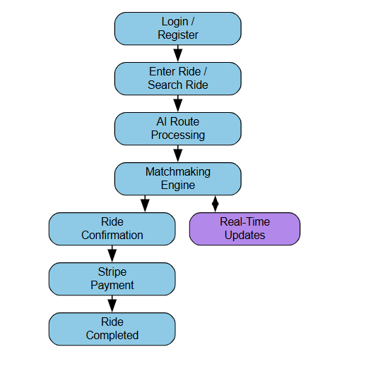
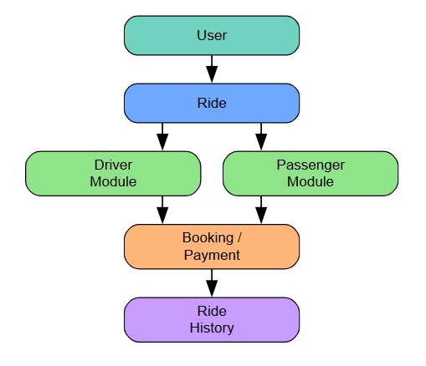
DESIGN ANALYSIS
Flowchart
ER Diagram

Slide 7
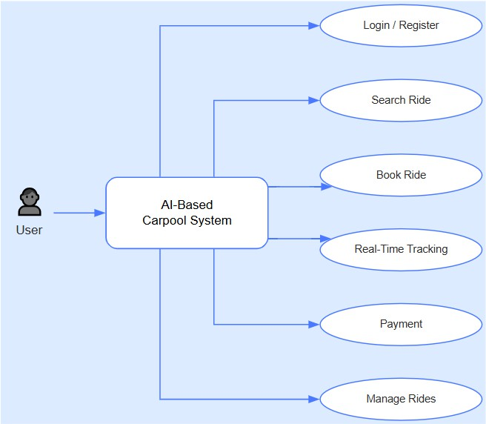
Use Case Diagram

Slide 8
PROPOSED METHADOLOGY
Technical Architecture
User Service(Auth + Profiles)
Ride Service(Ride Management)
AI Service (Confidence Scoring + NLP Explanations) Payment Service(Stripe)
PrimaryModel: "Hugging Face Mistral 8x7B"
The system uses a large AI language model from Hugging Face.It supports powerful reasoning and natural language processing.
CustomAI: "Custom heuristic algorithms"
Aside from the Mistral model, We have custom-developed AI logic for ride matching. Used for:Confidence Scoring,Multi Leg Planning & Dynamic Pricing

Slide 9
Hardware and Software Requirements
Minimum Hardware Requirements CPU: 4 cores
RAM: 8GB (16GB recommended)
Storage: 20GB free space
OS: Windows 10/11, macOS 10.15+, Ubuntu 18.04+
Software Requirements Node.js: 18.0+ LTS
npm/yarn: Package manager
Git: Version control
VS Code: Recommended IDE
MongoDB: 6.0+ (local or Atlas)

Slide 10
CONCLUSION AND FUTURE WORK
RouteShare showcases how AI can improve ride-sharing through smart route optimization, transparent matching, and real-time decisions. It is scalable, user-friendly, and contributes to sustainable and efficient urban transportation while laying the foundation for future intelligent mobility solutions.
Future Work
Personalization & Behavior Insights
Blockchain & Web3 Integration

Slide 11
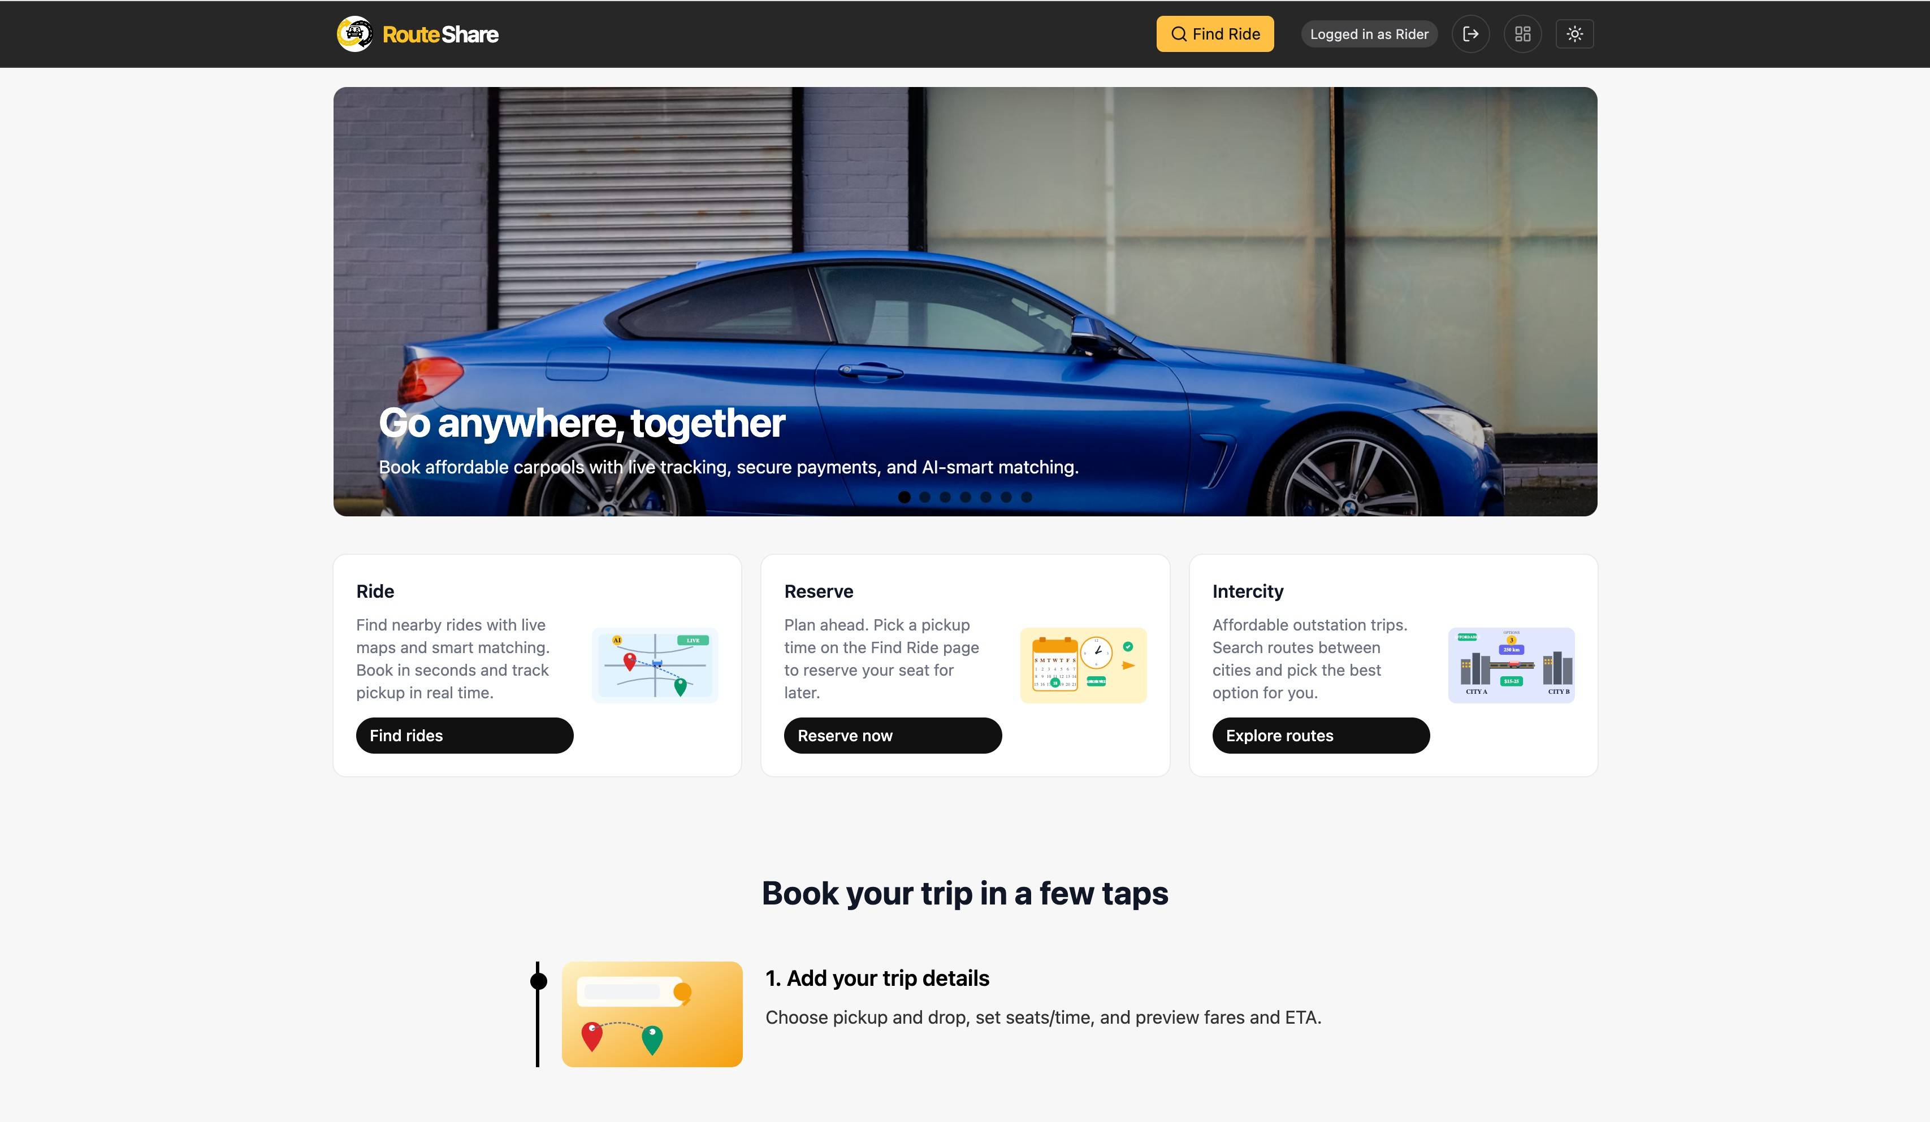
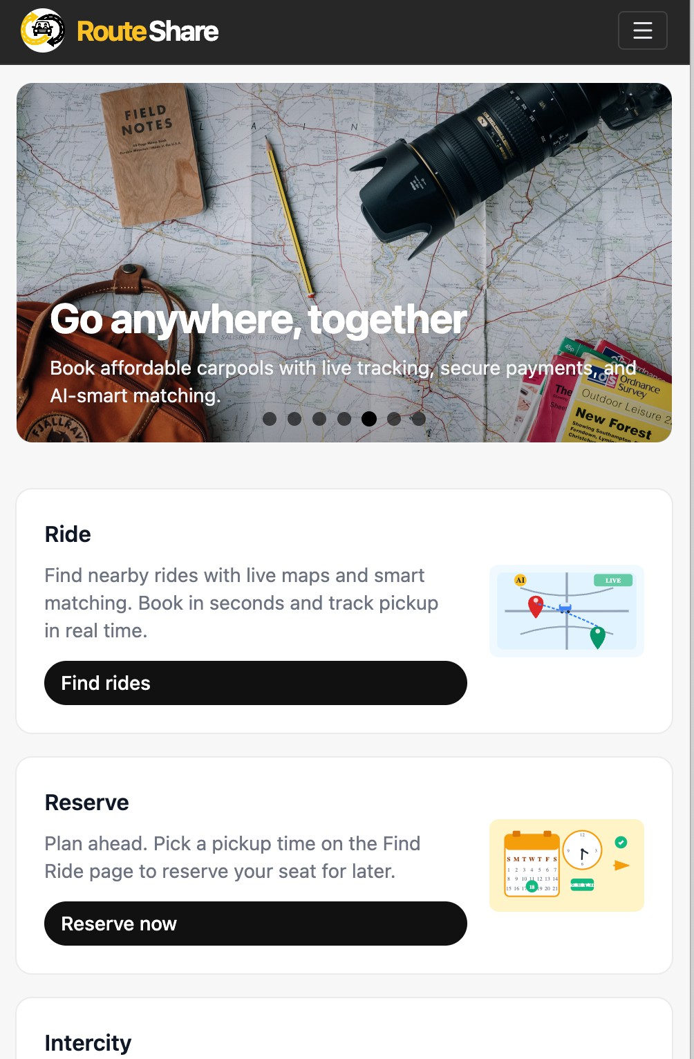
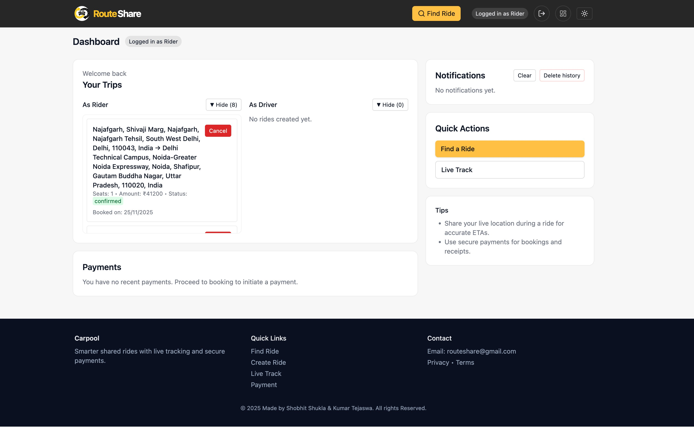
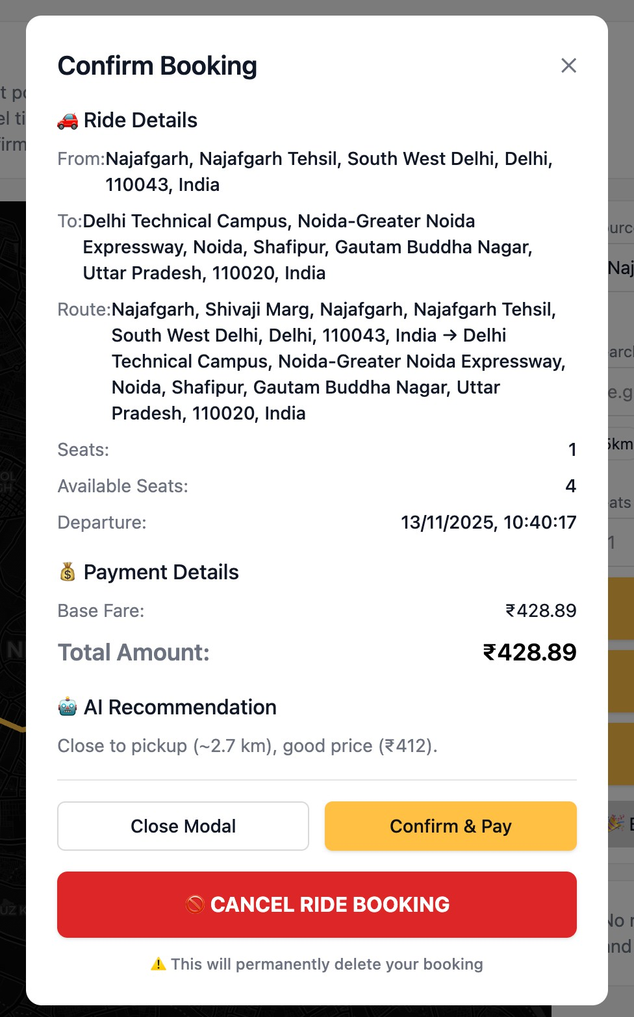
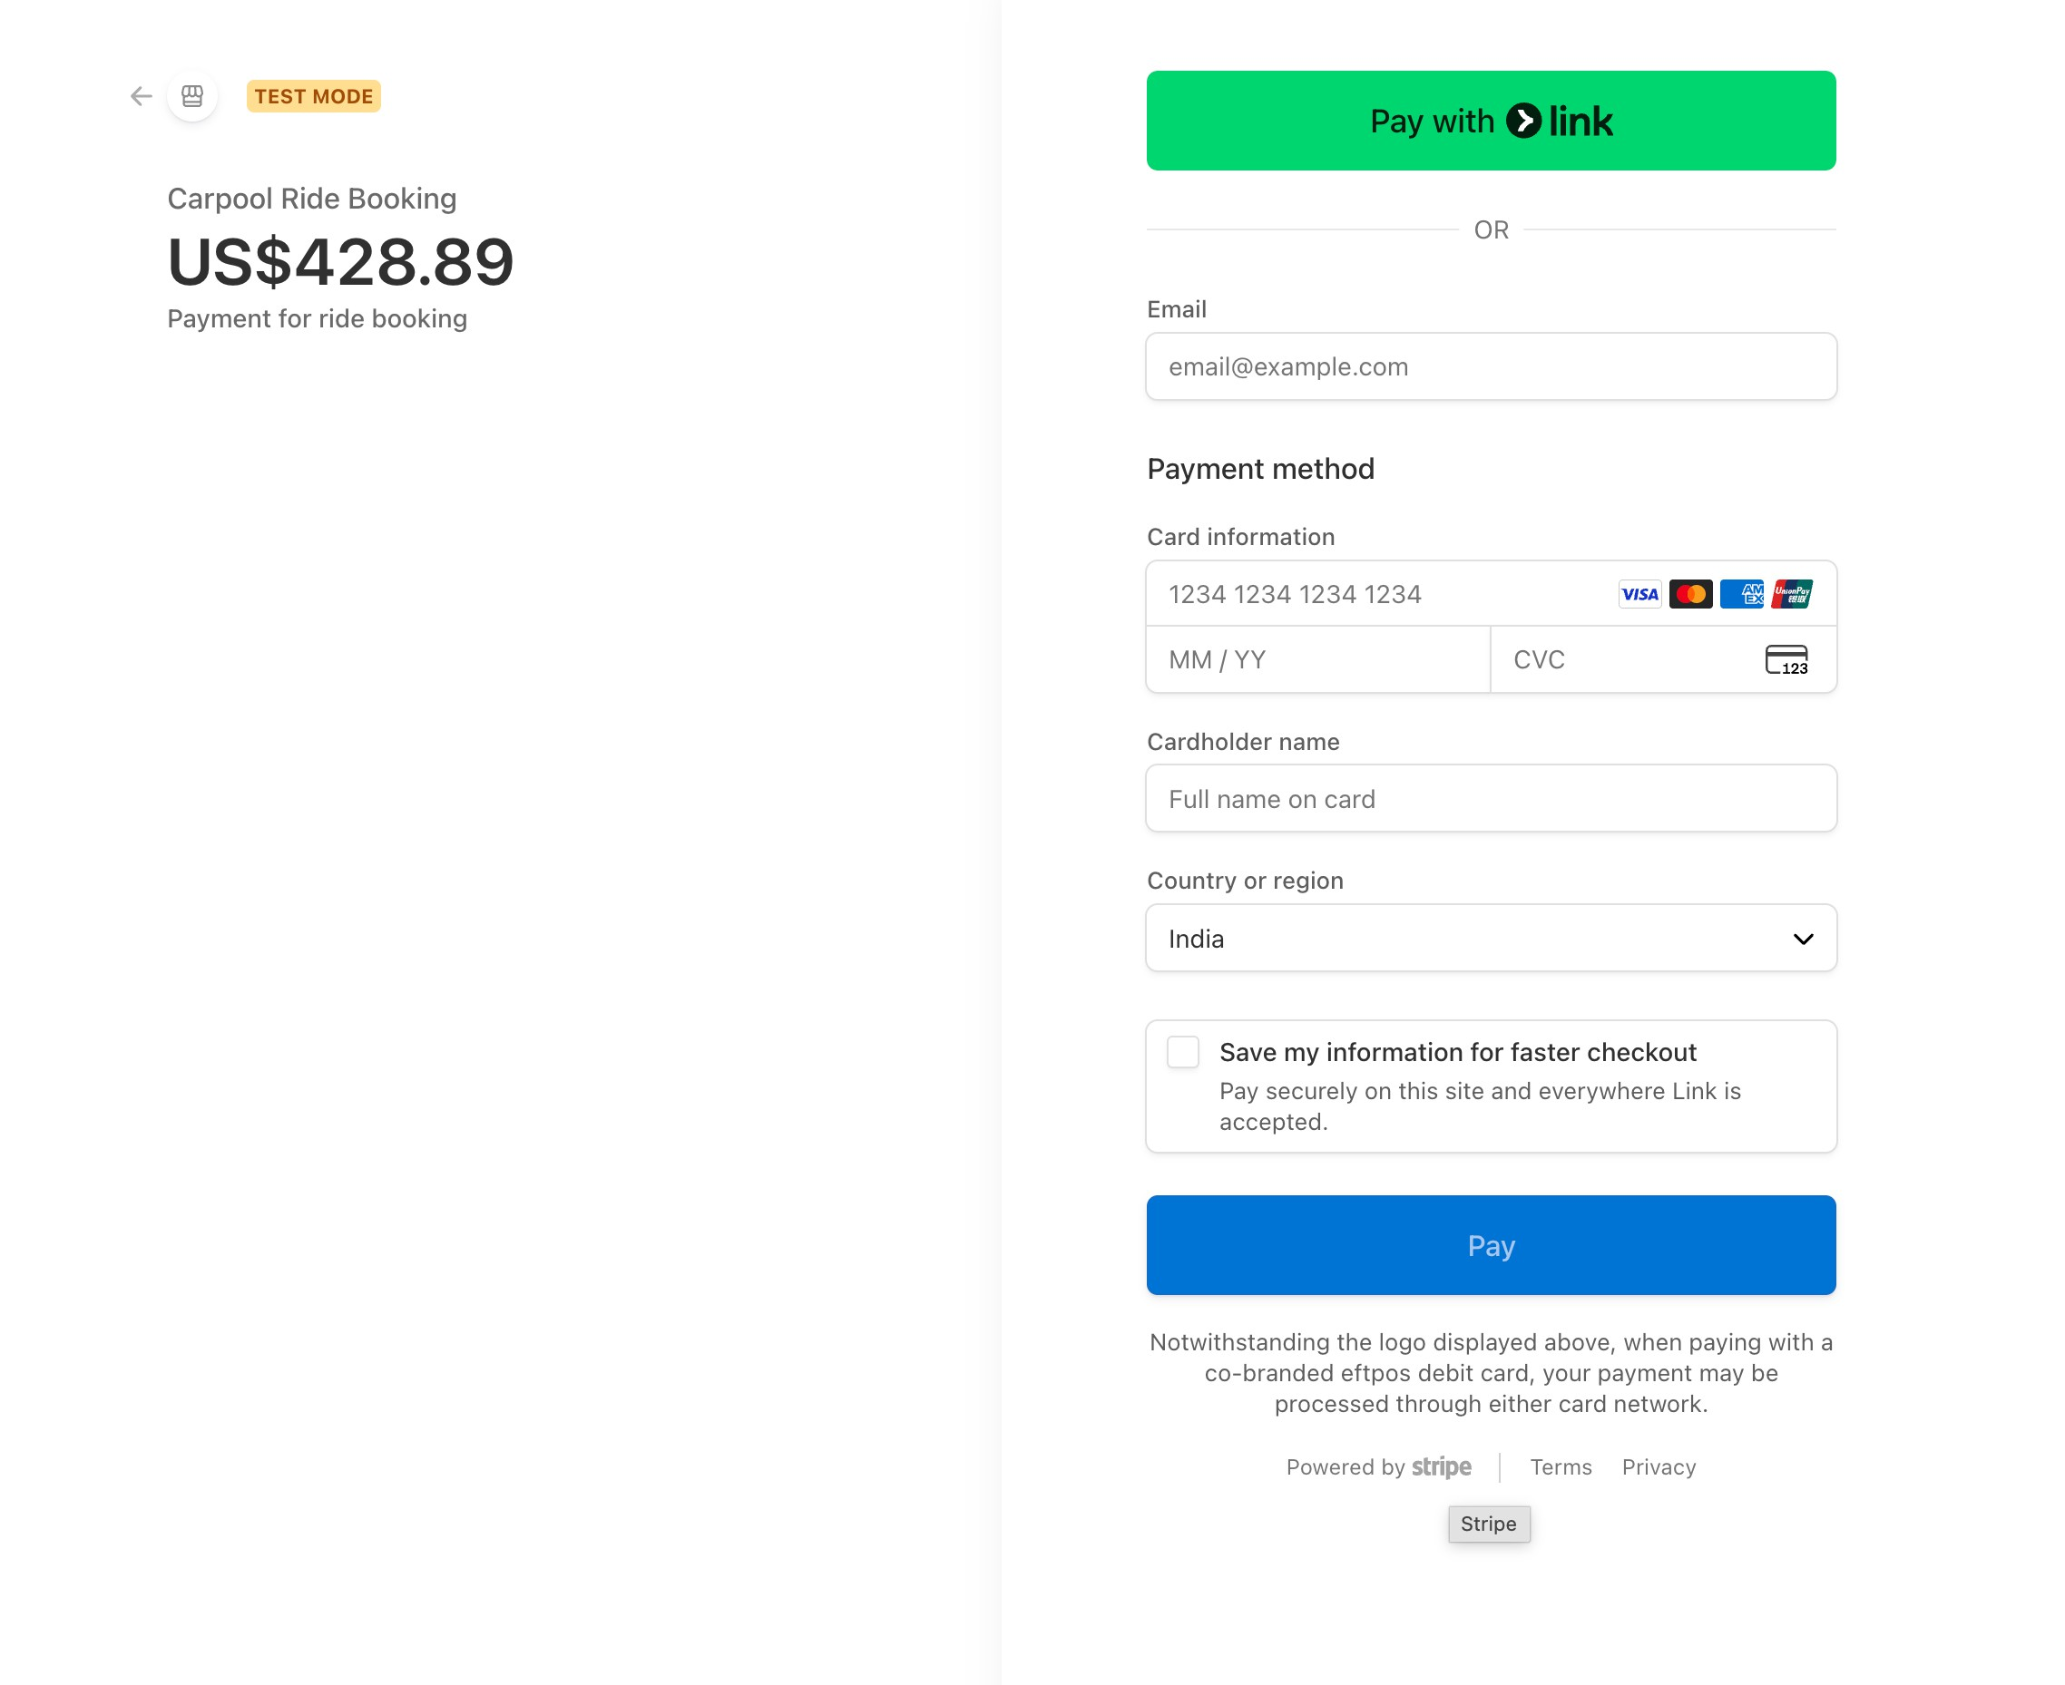
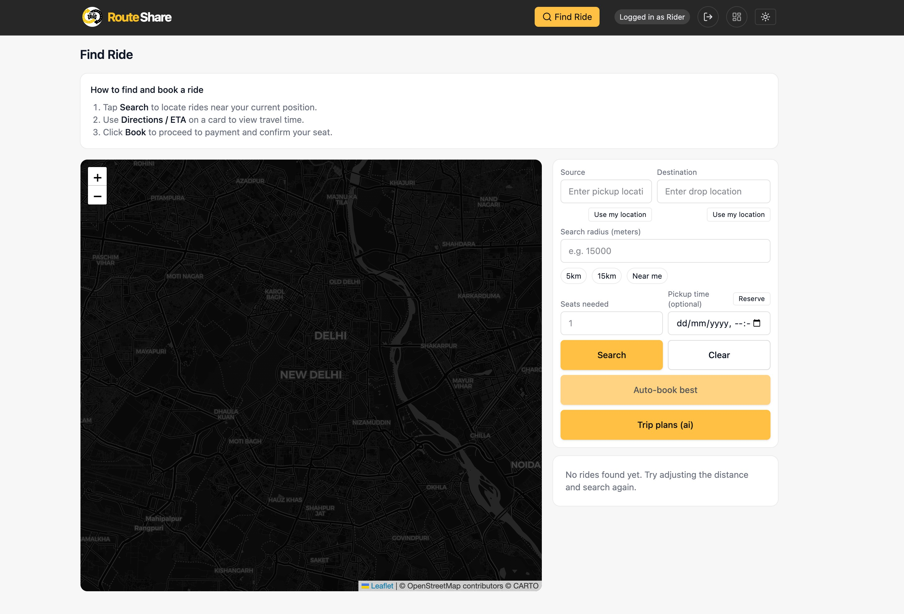
SCREENSHOTS

Slide 12
REFERENCES
Chen, Y., & Li, Z. (2023). "Artificial Intelligence in Transportation: A Comprehensive Review." *Journal of Intelligent Transportation Systems*, 27(3), 245-267.
Johnson, M. K., & Williams, R. (2023). "Real-Time Tracking Systems in Ride-Sharing Applications." *IEEE Transactions on Intelligent Transportation Systems*, 24(8),
7890-7905.
Uber Technologies, Inc. (2022). "Method and System for Dynamic Pricing in Ride-Sharing Services." U.S. Patent 11,345,678.
Node.js Foundation.. *Node.js Runtime*. Open Source Foundation.
MongoDB Inc. *MongoDB Database*. Open Source Project.
Stripe. *Stripe Node.js Library*. Open Source Project
Hugging Face. *Transformers Library*
w3schools.com

